Slide 1
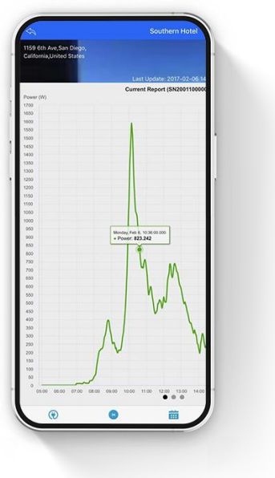
Microinverter
APP User Guide
APP User Guide
Northern Electric Power Co,. Ltd.
Date: 01/2024
Revision: V2.1

Slide 2

Content
Obtain NEPViewer App
Monitoring configuration
  Notice
  Create new account
  Add PV plant
  WiFi configuration (for iOS)
  WiFi configuration (for Android)
PV Plant introduction
Setting
Output Power Adjustment
Additional information

Slide 3
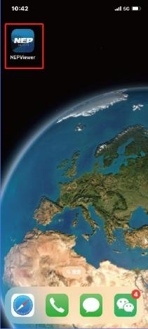


1. Get and Open NEPViewer
• Obtain NEPViewer App
• Open NEPViewer
Search for NEPViewer in App Store (iOS) or Google Play (Android )

Slide 4
2. Monitoring Configuration - Notice
DO NOT CONNECT AC
In the state of DC connected, AC disconnected, AP mode of the microinverter will be activated.If AC connected by accident, please unplug AC, DC to wait for memory clearance of the microinverter.

Slide 5
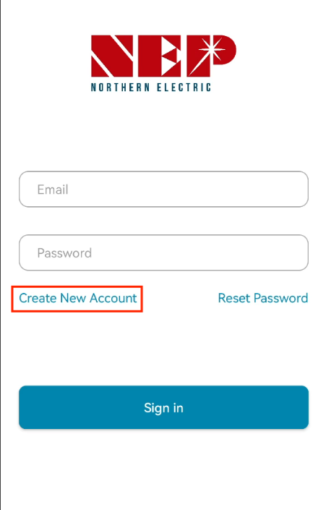
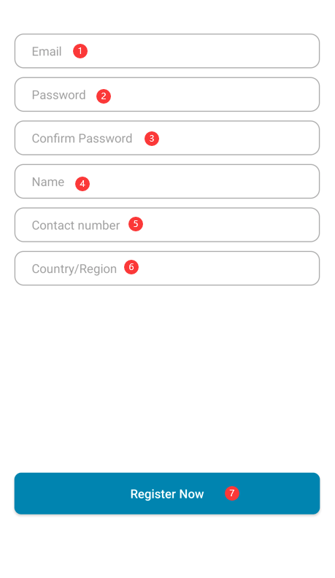
2. Monitoring Configuration - Create new account
• For first time use, you need to register first.
Enter e-mail format account
Enter your password (Password must be at least 6 characters)
Enter your password again for confirmation
Enter user ID
Enter your contact number (Optional)
Select Country/Region
Click "Register Now" (If registration succeeds, you will be logged in automatically. If registration fails, the reason for the failure will pop up.)

Slide 6
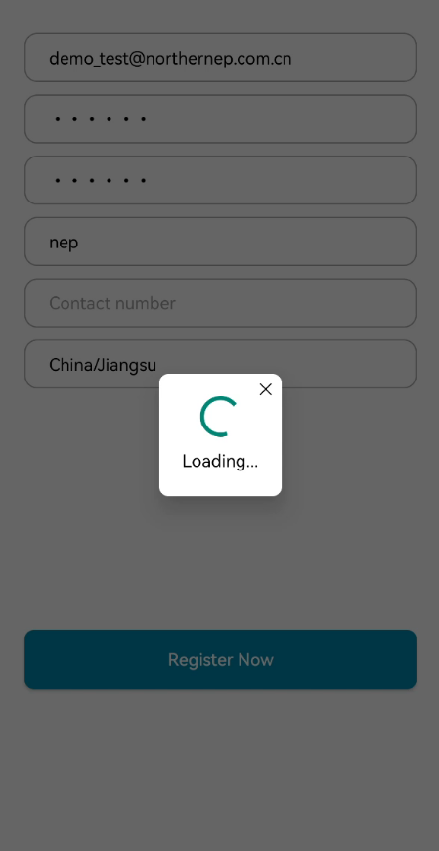
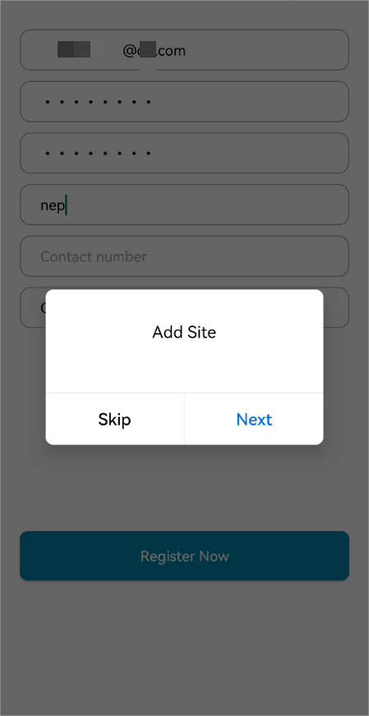
2. Monitoring Configuration - Create new account
• After filling out the information, click Register Now, a prompt box ‘Add Site’ will pop up.
• If you want to add PV Site, you can click Next.
• If you click Skip, you'll go to the homepage.

Slide 7
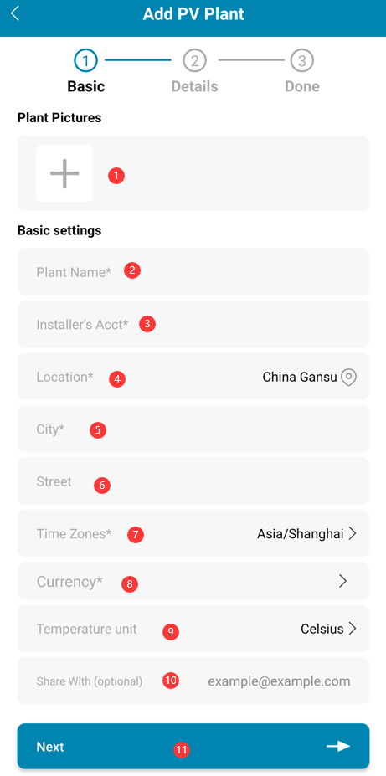
2. Monitoring Configuration - Add PV plant
Select photo of your plant (Optional. It will ask for authorization when you select photo from your gallery.)
Enter plant name (Necessary)
Enter installer e-mail (Necessary)
Click "Location" (Necessary. It will read country and region from where you are registering this site.)
Enter city name (Necessary)
Enter street name (Optional)
Click "Time zone" (Necessary. It will read time zone of "Location". If "Location" is modified, "Time zone" will be modified simultaneously.)
Currency (Necessary)
Select temperature unit (Optional)
Enter other viewer (Optional. You can enter multiple email addresses separated by ",". )
Note: Others could see your plant information if you share it to them
Click "Next" to submit info which will be verified. Account will be created if there is no abnormalities.

Slide 8
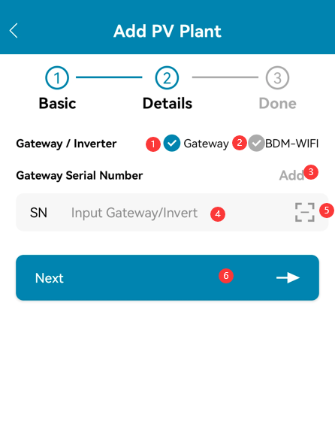
2. Monitoring Configuration - Add PV plant
• If you're using a No-WiFi device (PLC communication), select Gateway, then enter the SN Code and click Next. (only digits and letters in small capital)
• If you're using a WiFi device, select BDM-WiFi, then follow the following tutorial for WiFi Configuration.

Slide 9
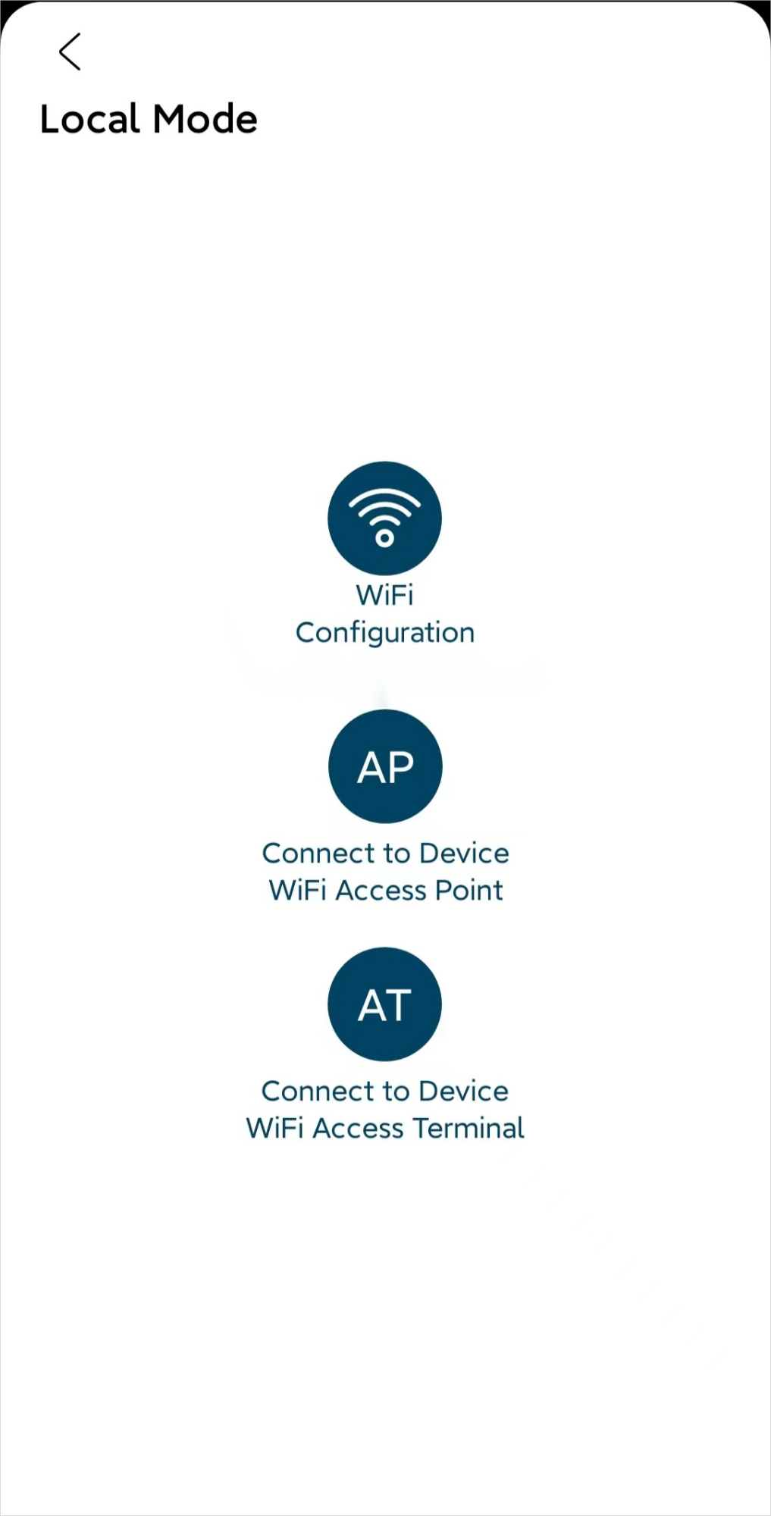
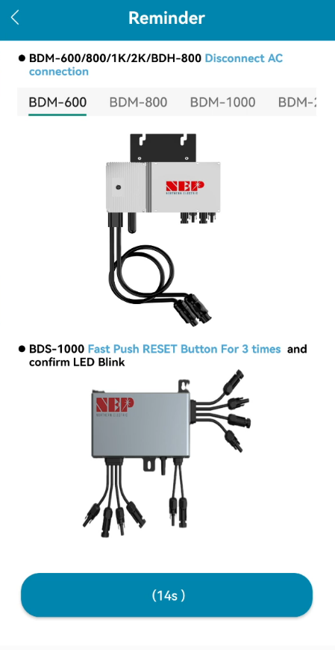
2. Monitoring Configuration - WiFi configuration
• Page 16~22 is for Android
• Page 10~15 is for iOS

Slide 10
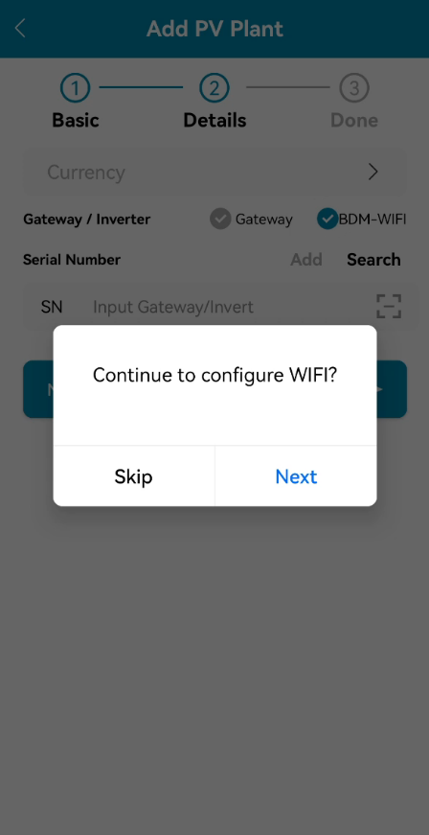
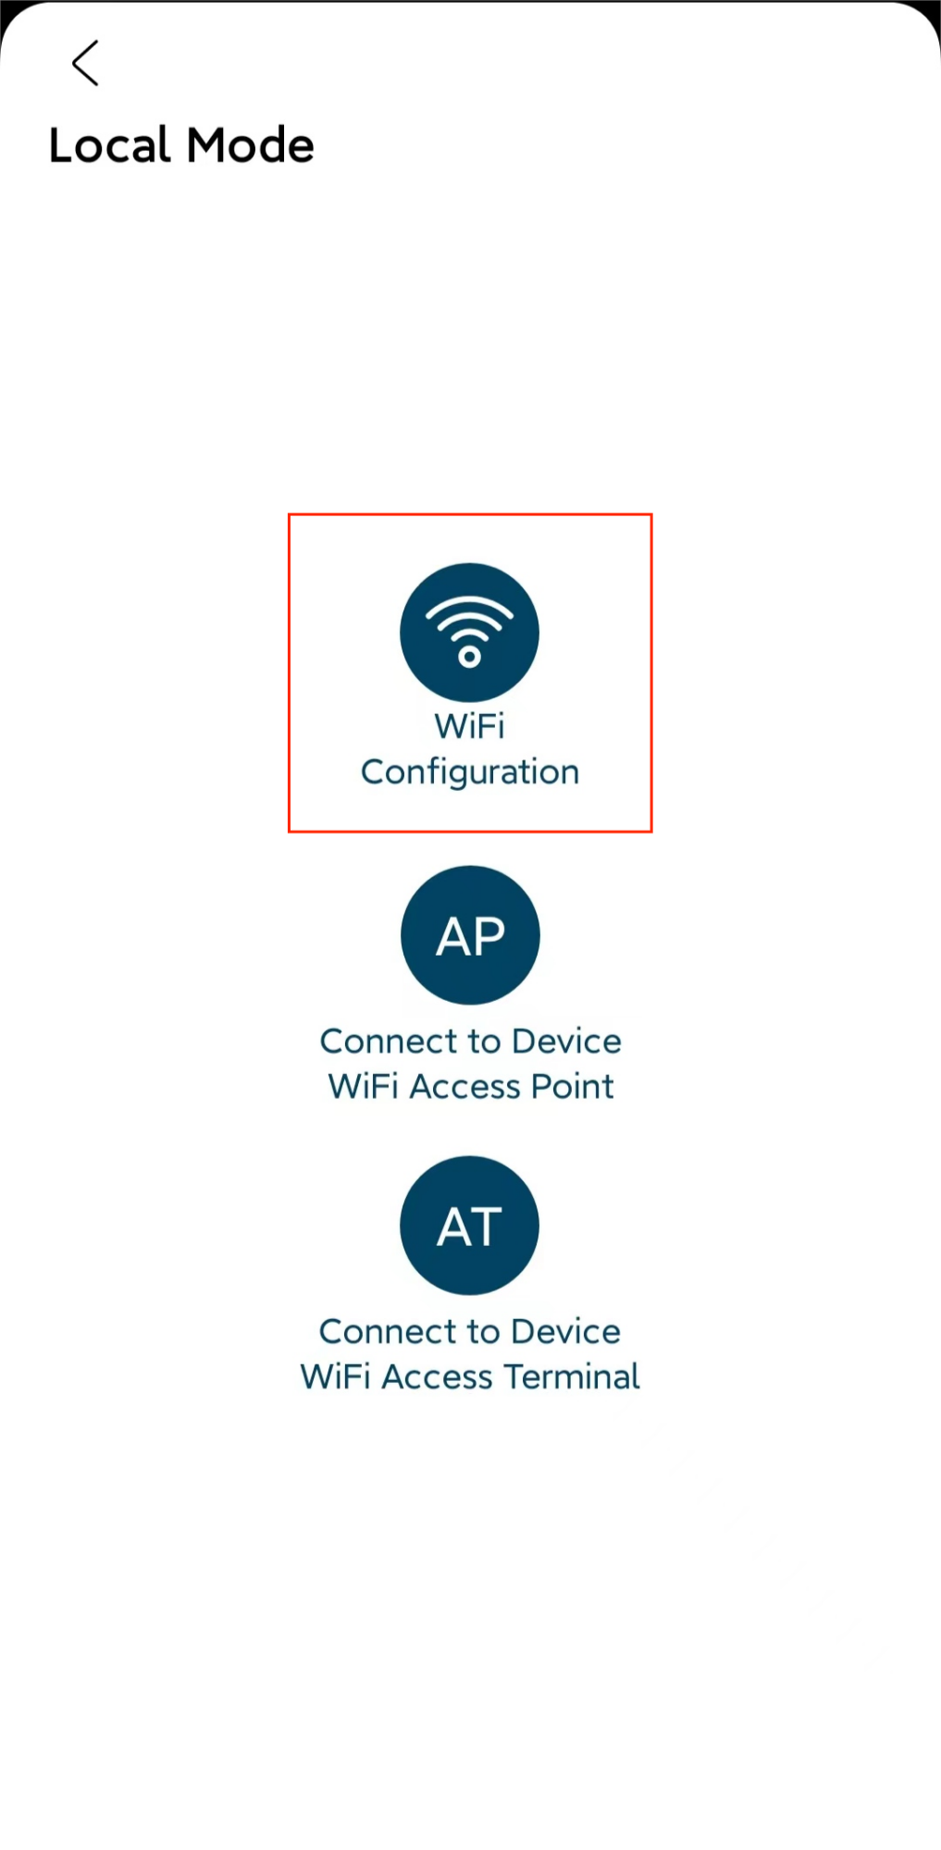
2. Monitoring Configuration - WiFi configuration (for iOS)
• If you select BDM-WiFi, a prompt box ‘Continue to configure WIFI’ will pop up, click NEXT and click WiFi Configuration.
Reminder:
• For BDM600/800/1000/2000&BDH800:
Please make sure disconnect the AC
• For BDS1000:
Fast push RESET Button for 3times and confirm LED blinking
Note: RESET Button is on the right side of BDS1000)

Slide 11
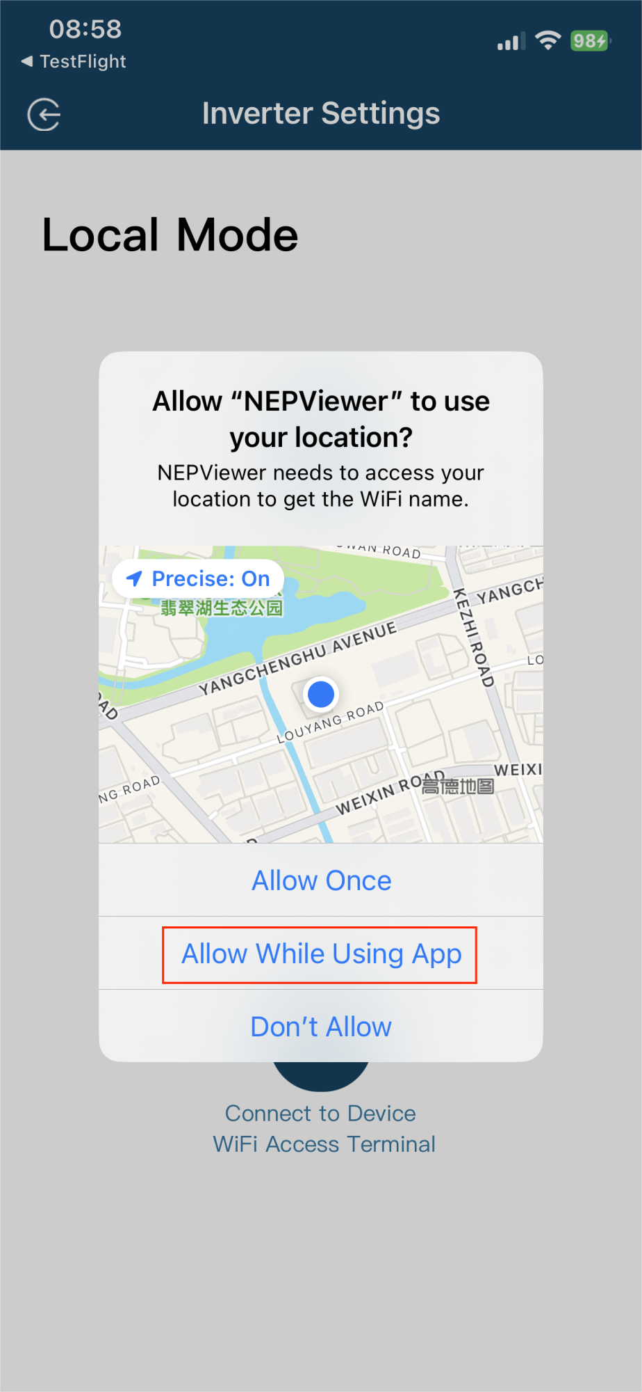
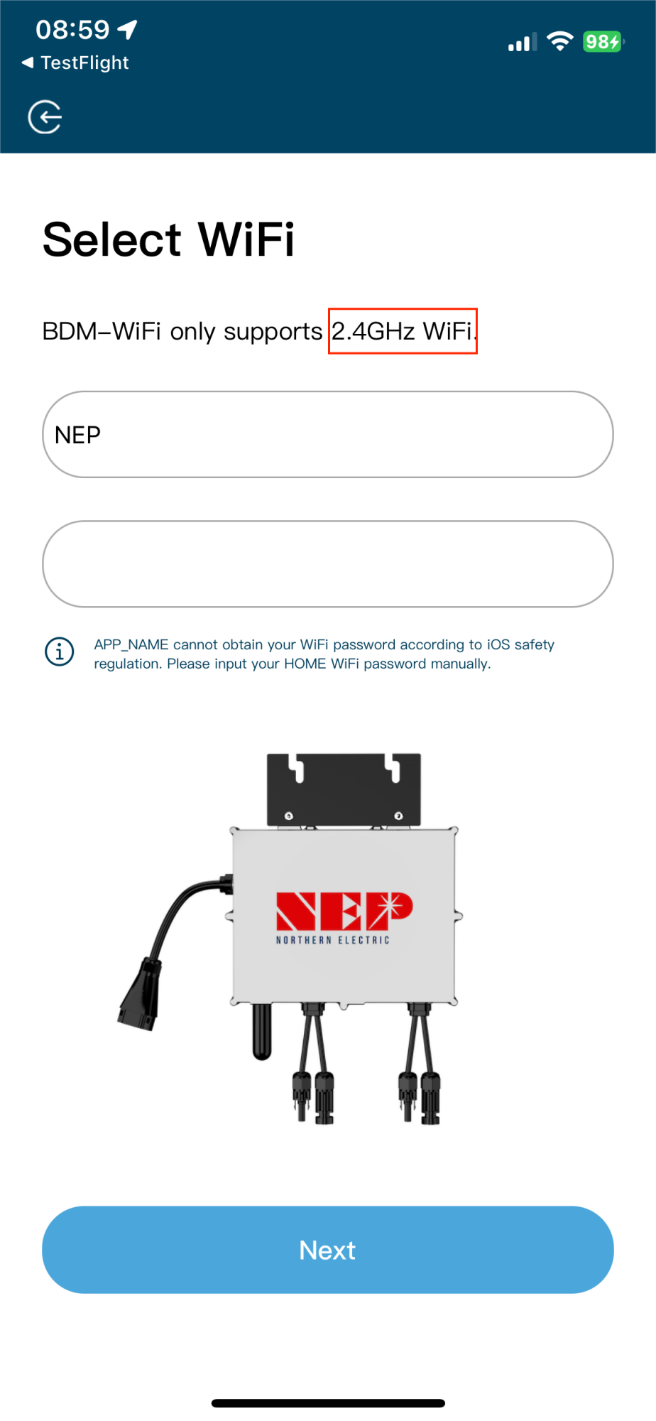
2. Monitoring Configuration - WiFi configuration (for iOS)
• Click Allow to obtain geographic location permission (only pops up when installing the app for the first time).
• Enter the home WiFi name (the current connected WiFi will be obtained by default).
• Enter the home wifi password (manual input is required).

Slide 12
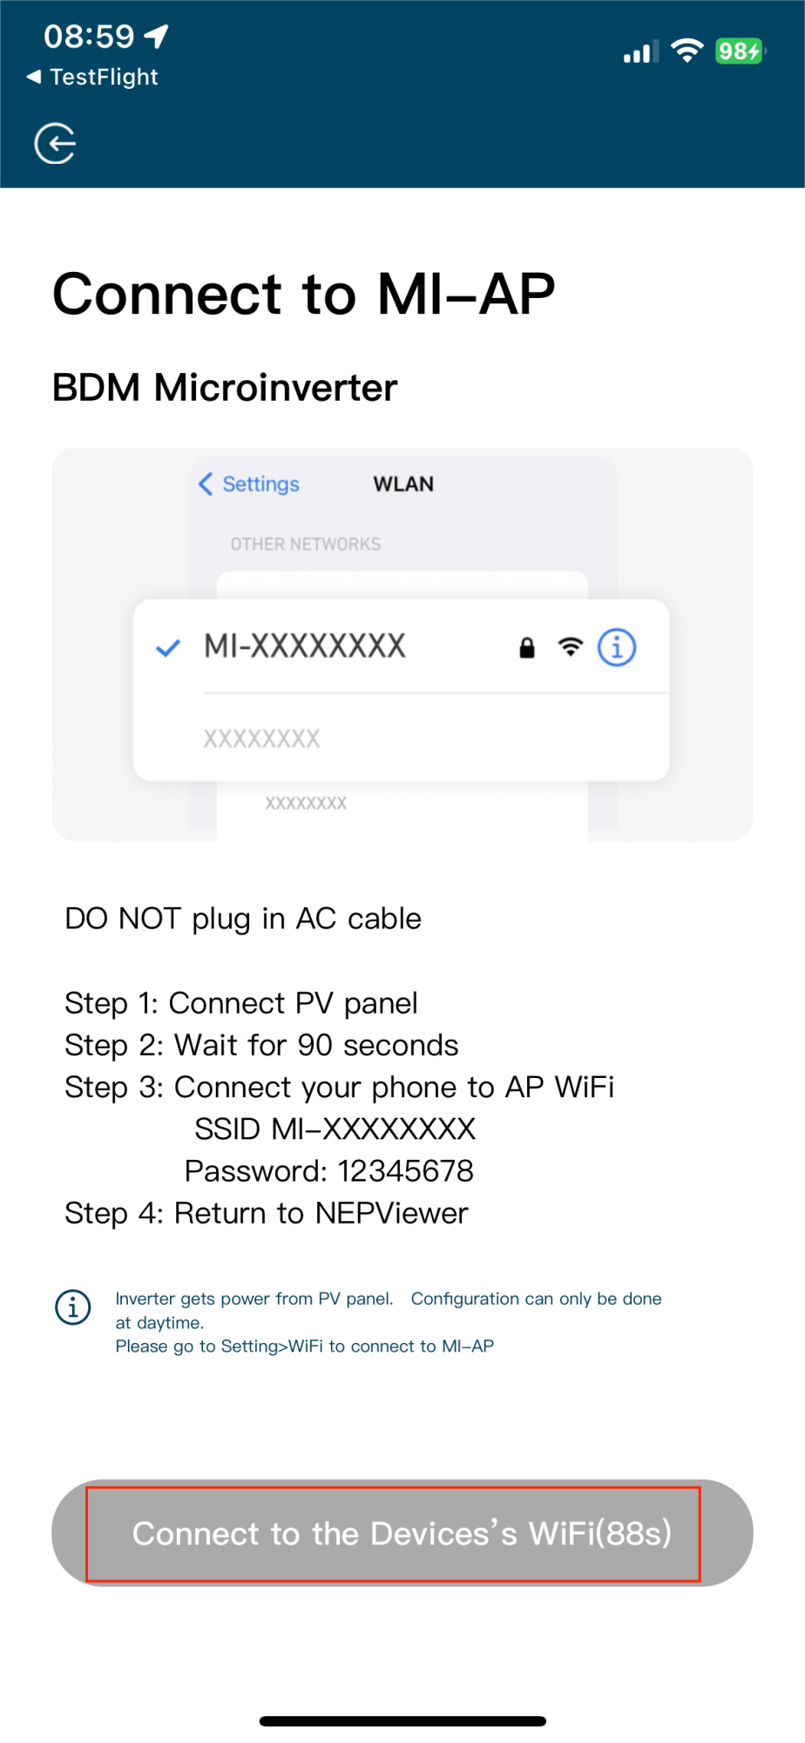
2. Monitoring Configuration - WiFi configuration (for iOS)
• Read the corresponding steps carefully within 90 seconds of the countdown and check that only DC is plugged in.

Slide 13
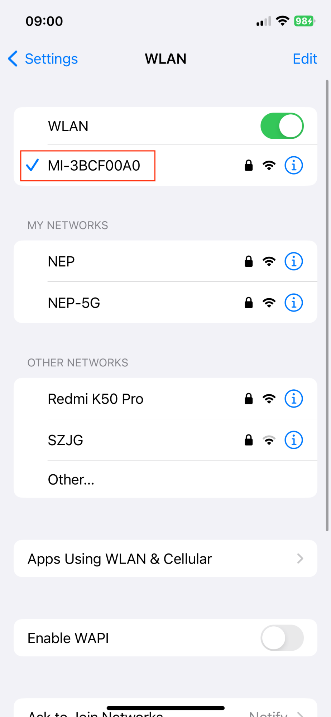
2. Monitoring Configuration - WiFi configuration (for iOS)
• After the countdown ends (the button turns blue), you can jump to the WLAN setting page to connect to the hotspot SSID: MI-XXXXXXXX
• Password: 12345678
• Return to NEPViewer app.

Slide 14
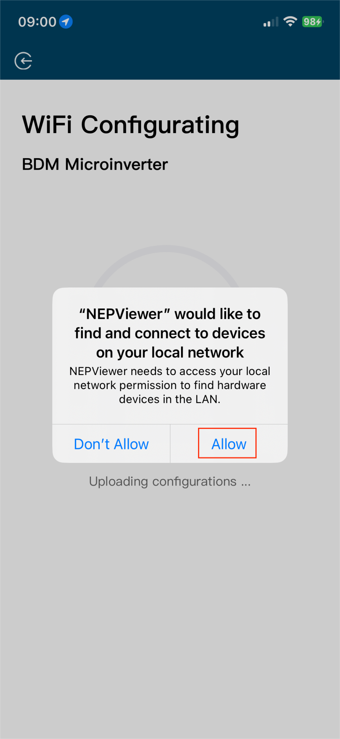
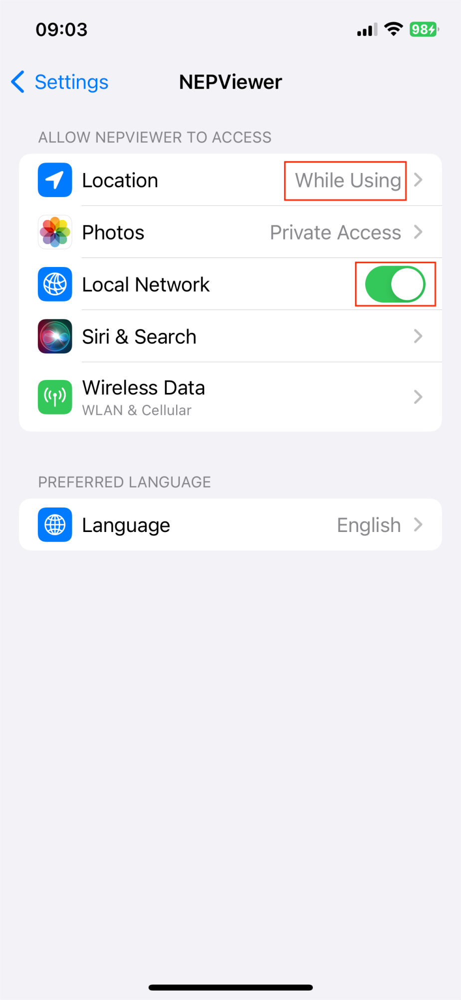
2. Monitoring Configuration - WiFi configuration (for iOS)
• Allow connection to local network (It will pop up only when the app is installed for the first time)
• Check this permission you can go to phone settings - NEPViewer - open local network
• Wait for 50s for the device to complete configuration and restart.

Slide 15
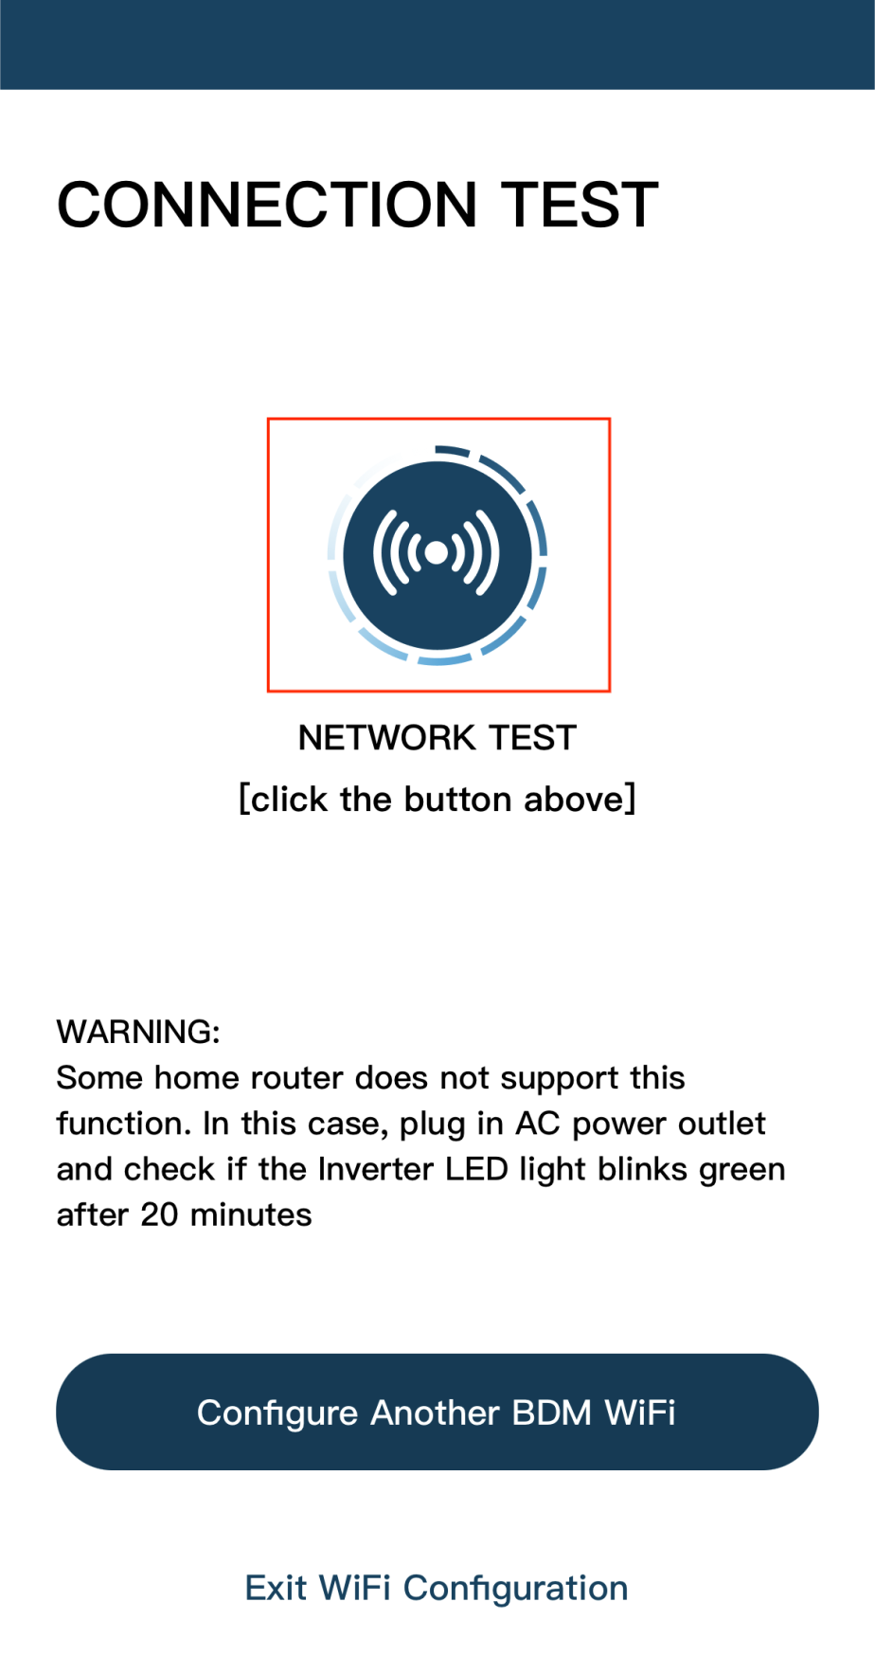
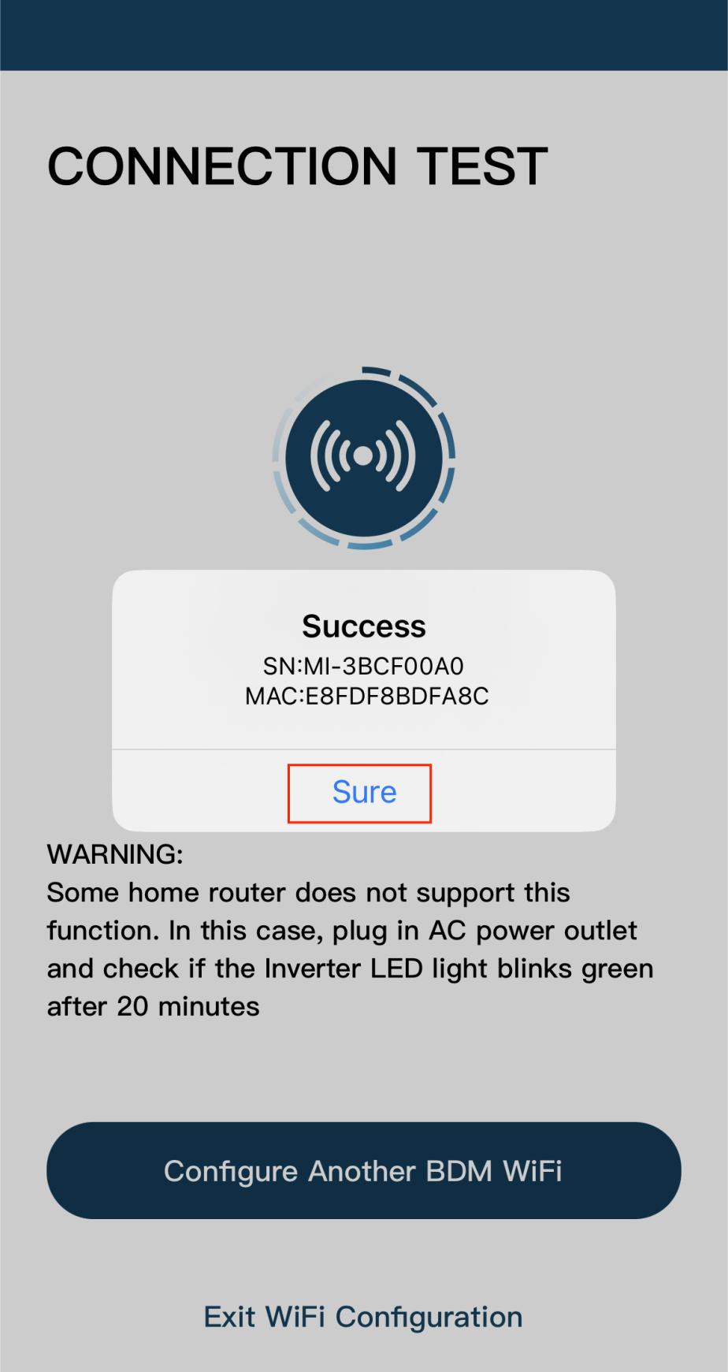
2. Monitoring Configuration - WiFi configuration (for iOS)
• Click the button to check the connectivity (provided that the current WiFi is connected
to the home WiFi.
• Click Sure, click Exit, the WiFi configuration
has been completed at this time.

Slide 16
2. Monitoring Configuration - WiFi configuration (for Android)
• If you select BDM-WiFi, a prompt box ‘Continue to configure WIFI’ will pop up, click NEXT.
Reminder:
• For BDM600/800/1000/2000&BDH800:
Please make sure disconnect the AC
• For BDS1000:
Fast push RESET Button for 3times and confirm LED blinking
Note: RESET Button is on the right side of BDS1000)

Slide 17
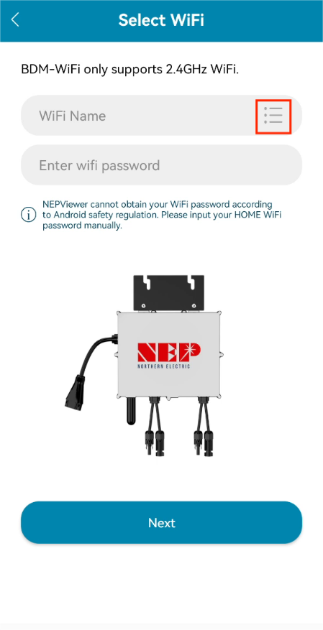
2. Monitoring Configuration - WiFi configuration (for Android)
• Enter home WiFi Name and Password.
• You can click the right icon, scan for Home WiFi (Allow geolocation permissions when installing the app for the first time).
• Click Next to verify that the home WiFi information is correct.

Slide 18
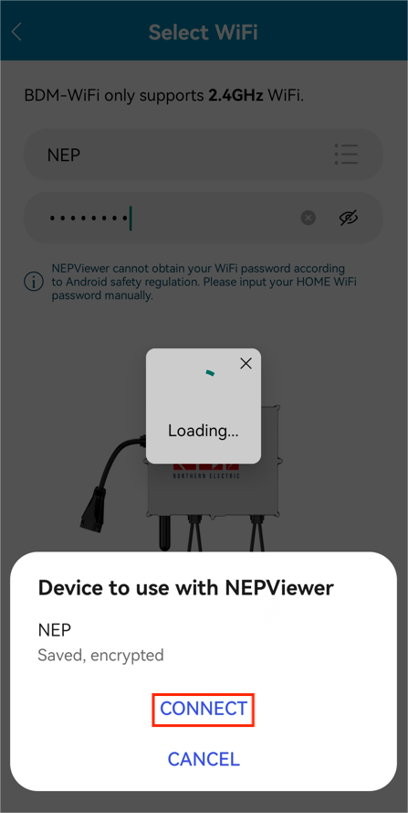
2. Monitoring Configuration - WiFi configuration (for Android)
• Verify that the home WiFi information.
• If the phone is connected to the home WiFi, the APP will enter the NEP device scanning page.
• If the phone is not connected to the home WiFi, the APP will pop up the option to connect to the home WiFi, make sure the home WiFi name and password entered are correct.

Slide 19
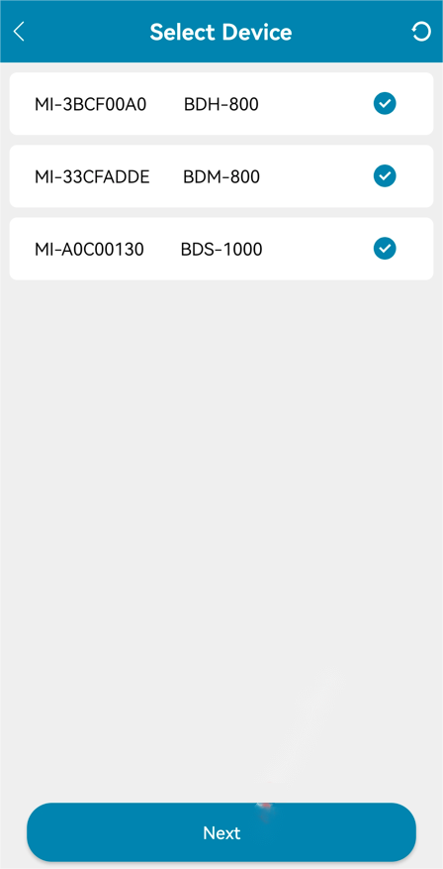
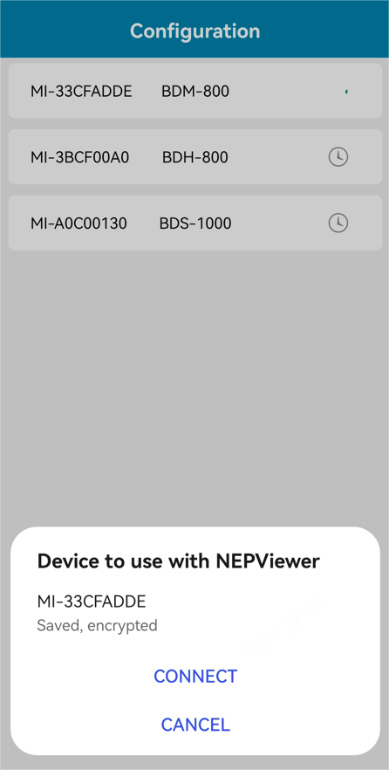
2. Monitoring Configuration - WiFi configuration (for Android)
• Select the device that requires WiFi configuration.
• Click Next to go to the WiFi configuration page.
• Click CONNECT to connect the NEP device.

Slide 20
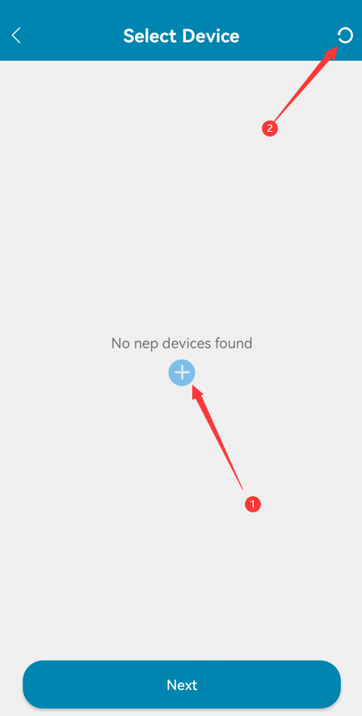
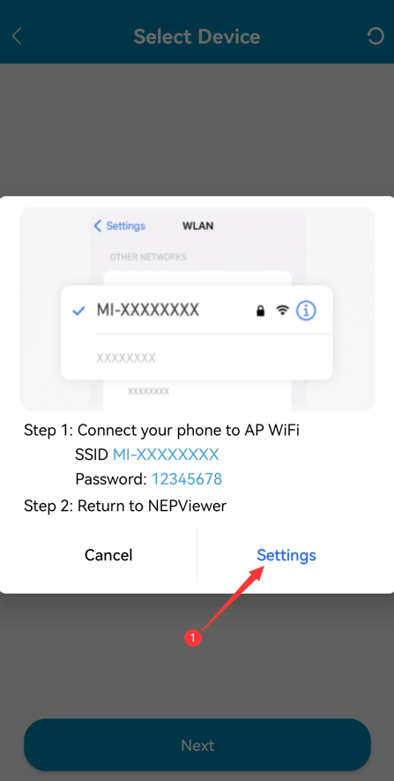
2. Monitoring Configuration - WiFi configuration (for Android)
• If no NEP device shows up:
Click the button to pop up the WIFI setting pop-up window
Click to refresh and search for nearby NEP devices
Click Settings to enter the mobile phone connection WiFi interface

Slide 21
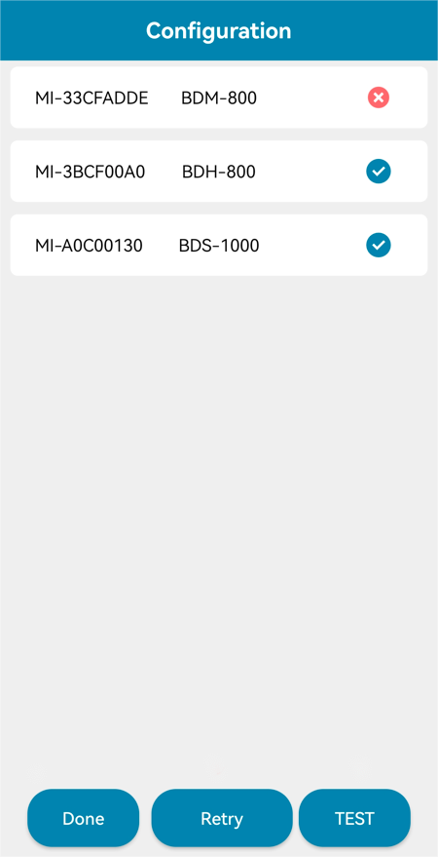
2. Monitoring Configuration - WiFi configuration (for Android)
• When there is a failed device, the Retry button will appear for easy re-networking.
• Click TEST to go to the connectivity test page.

Slide 22
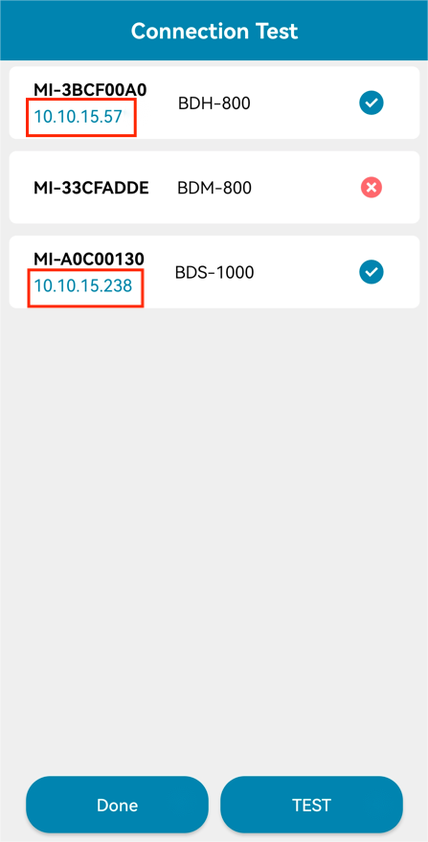
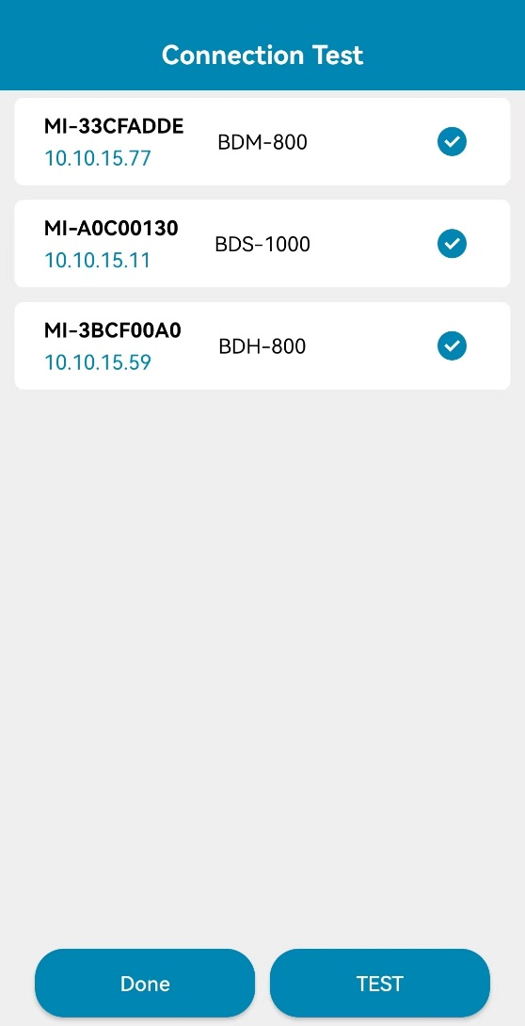
2. Monitoring Configuration - WiFi configuration (for Android)
• Successful connectivity detection will display the IP address.
• For the one without IP address, please try the TEST again.
• Click Done to complete and exit the Configuration page.

Slide 23
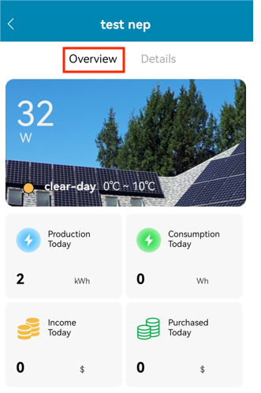
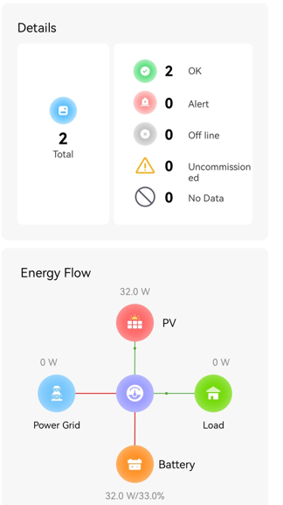
3. PV Plant introduction
• Include the real-time power, weather, income, equipment status, equipment energy flow indication and environment benefit information of the power station.

Slide 24
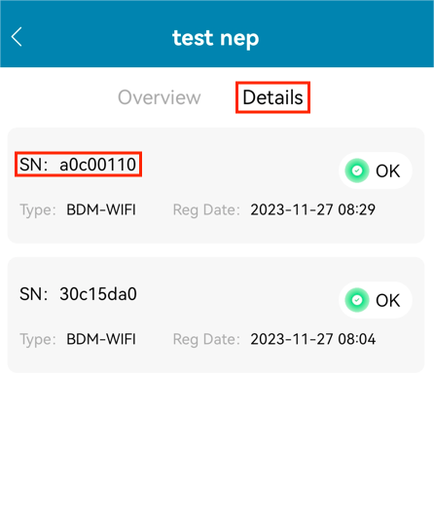
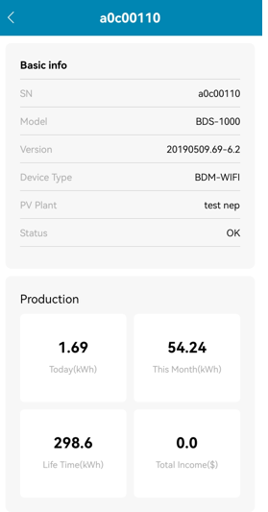
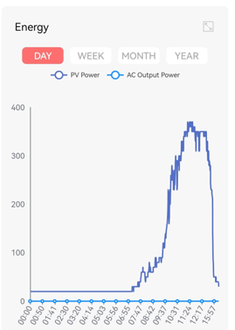
3. PV Plant introduction
Click the related SN

Slide 25
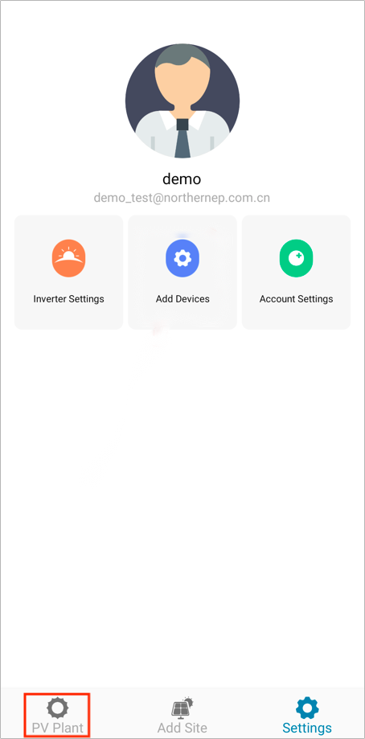
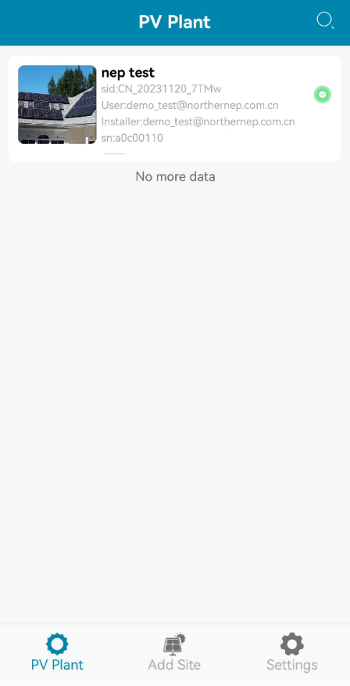
3. PV Plant introduction
• Enter the APP homepage, select PV Plant.
• You can see all the sites you've added.
• Click on any site you added before, you'll see it in detail.

Slide 26
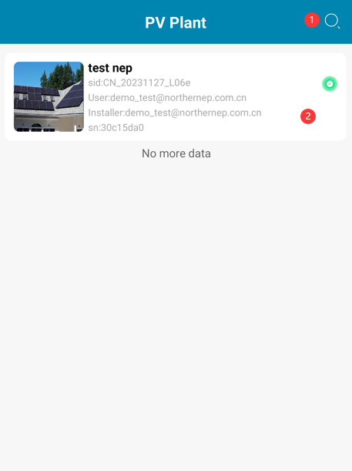
3. PV Plant introduction
• PV Plant page will display PV plant name, user e-mail and installer e-mail.
Click search box to search page
Click PV plant to detailed page
Note:
• Long press PV plant to for a dialog of edit or delete option.

Slide 27
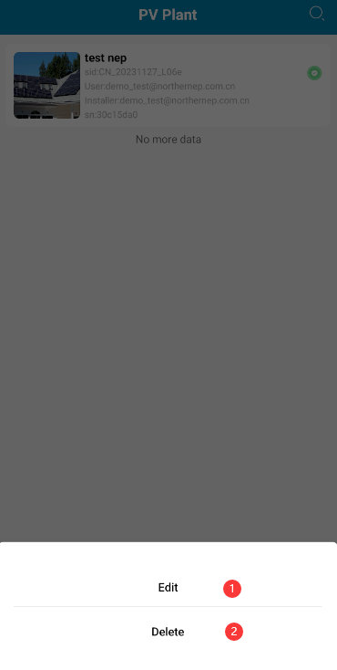
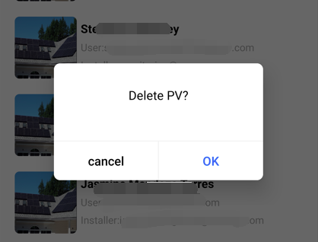
3. PV Plant introduction
• Long press the PV Plant, then you could edit or delete the PV plant.
Edit PV plant
Delete PV plant
• Click "OK" to delete. List will refresh after delete.
• Click "cancel" to close dialog

Slide 28
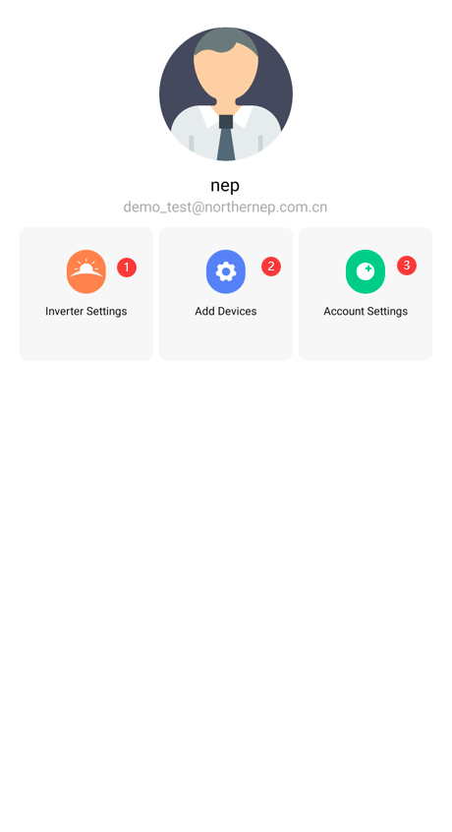
4. Setting
Inverter setting
Add devices to the PV Plant
Account setting

Slide 29
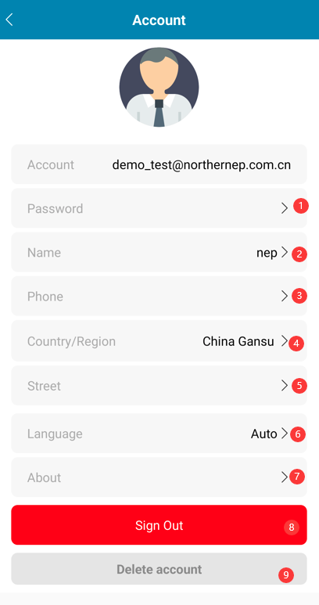
4. Setting
Reset the password
Change the account name
Change the phone number
Select the country/Region
Stress address
Set language
About NEP
Sign out
Delete account

Slide 30
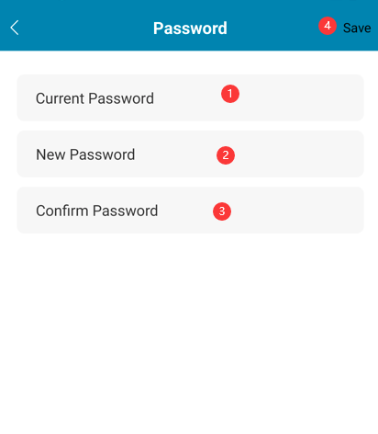
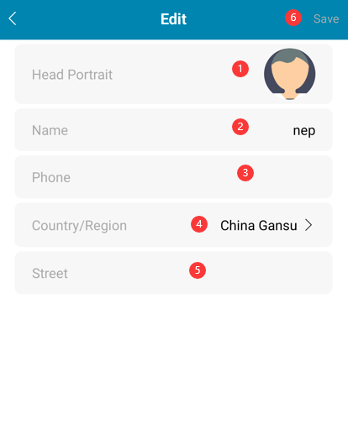
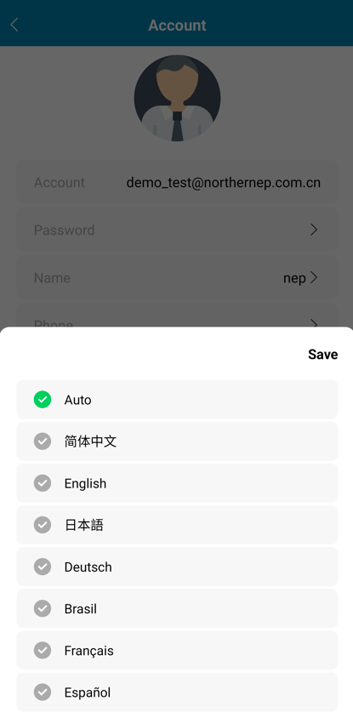
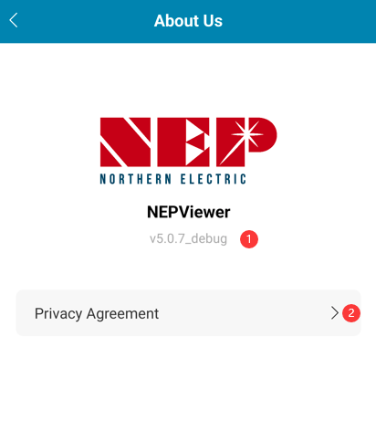
4. Setting
Reset the password
About NEP
APP version
Privacy agreement
Change the account
information
Set language

Slide 31
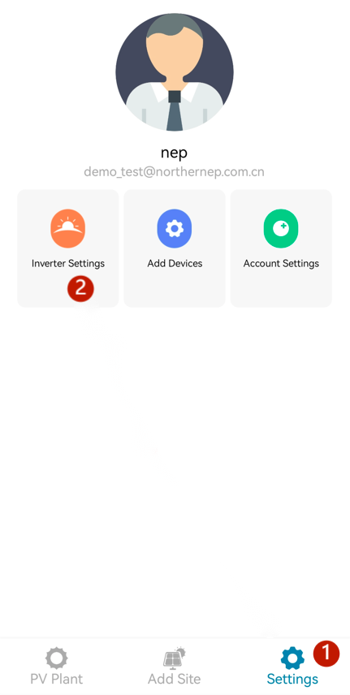
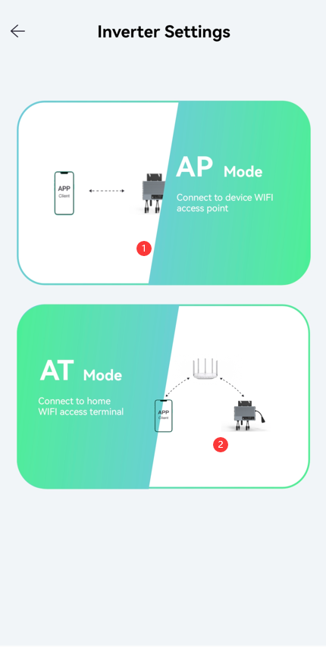
5. Output Power Adjustment
Select Local Mode
BDM needs to be in AP mode when you used this mode. Your phone needs to connect to BDM hotspot, see in step 3.1.
BDM and your phone need to connect to the same WiFi when you uss AT mode, see in step 3.2.
1. Settings
2. Inverter Settings

Slide 32
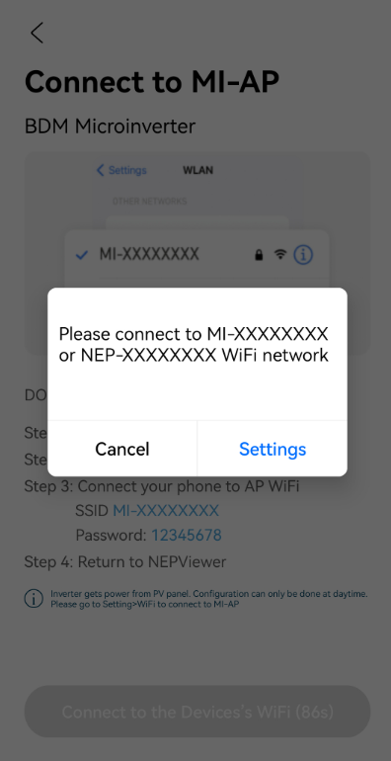
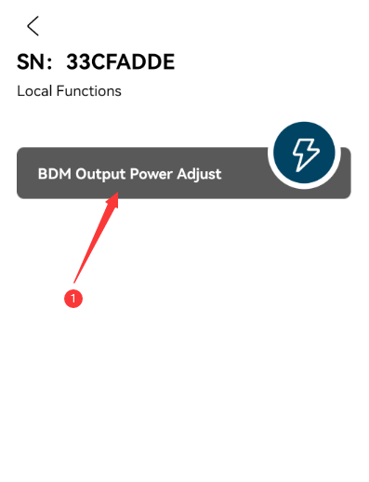
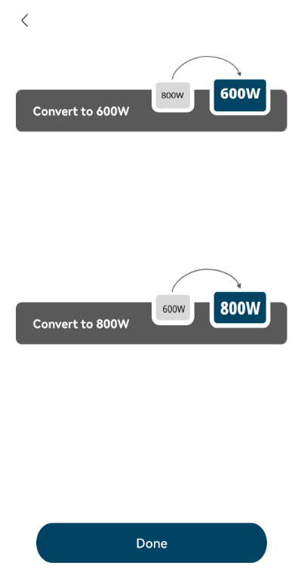
5. Output Power Adjustment - AP Mode
If your phone is connecting to the BDM hotspot, "BDM Output Power Adjust" button will display itself.
If you phone is not connecting to the BDM hotspot, a dialog will pop up.
1. 800W-600W
2. 600W-800W

Slide 33



5. Output Power Adjustment - AT Mode
Select BDM-800 or other version
1. 800W-600W
2. 600W-800W

Slide 34


6. Additional information
• Typical connection scheme diagram
• LED explanation

